Slide 1
Flight Testing Small UAVs for Aerodynamic Parameter Estimation
Adam T. Chase and Robert A. McDonald
California Polytechnic State University

Slide 2
Motivation
Lack of small UAV lift/drag regression models
Small UAVs do not fly “steady-level”
Designers need data to conduct quantitative trades
Off the shelf systems not sufficient
No air data system
Closed source, lack of error propagation

Slide 3
Goals
Integrate air data acquisition system into flight vehicle
Measure drag polar and lift curve slope from flight test
Quantify changes in vehicle performance from configuration changes

Slide 4

Equations of Motion
Newton’s 2nd Law, in body axes:
$$ΣF=\frac{d}{dt}\left(mV\right)$$
Fixed mass assumption (electric aircraft):
$$ΣF=ma$$
Applied forces:
$$ΣF=F_{AERO}+F_{G}+F_{T}$$
Assume no thrust:
$$ΣF=F_{AERO}+F_{G}$$

Slide 5

Assumptions
Re-arrange terms:
$$ΣF=ma$$
$$F_{AERO}+F_{G}=ma$$
$$F_{AERO}+mg=ma$$
$$F_{AERO}=m\left(a−g\right)$$
$$F_{AERO}=−m r$$
Rotate from body to wind axes:
$$F_{AERO}^{w}=R_{b}^{ w}F_{AERO}^{b}$$
where
$$R_{b}^{w}=f(α,β)$$
Only an accelerometer and an air data system are required to get lift/drag forces in gliding flight

Slide 6
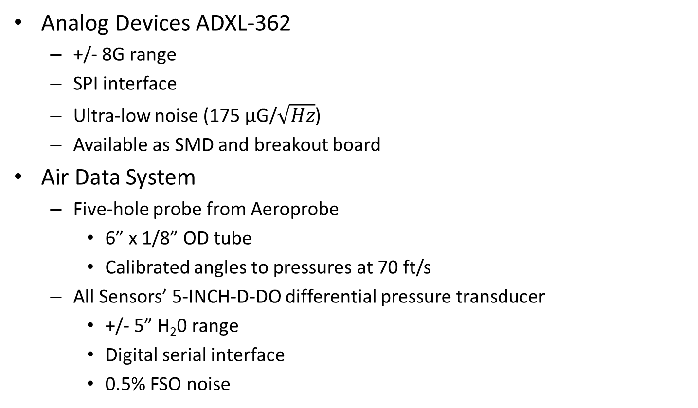
Sensor Selection
Analog Devices ADXL-362
+/- 8G range
SPI interface
Ultra-low noise (175 μG/$\sqrt{Hz}$)
Available as SMD and breakout board
Air Data System
Five-hole probe from Aeroprobe
6” x 1/8” OD tube
Calibrated angles to pressures at 70 ft/s
All Sensors’ 5-INCH-D-DO differential pressure transducer
+/- 5” H₂0 range
Digital serial interface
0.5% FSO noise

Slide 7
Additional Sensors
ITG-3200 gyroscope
Euler angles
U-Blox LEA-6T GPS receiver
Euler angle correction, flight visualization
HMR-2300 magnetometer
High accuracy, used for slow or vertical flight
HMC-5883L magnetometer
Small, inexpensive
Barometric pressure transducer
Barometric pressure/altitude
DS18B20 temperature sensor
Allows density/air speed calculation
Servo PWM signal
Isolates flight without throttle

Slide 8
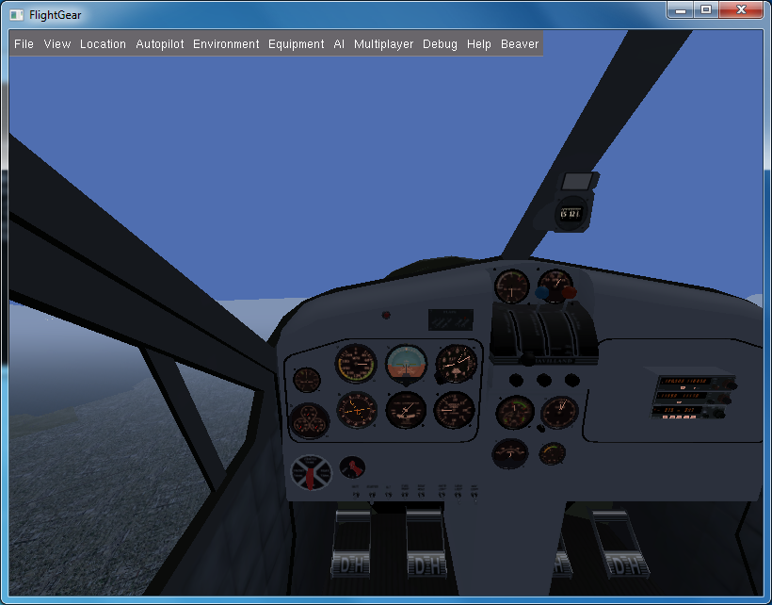
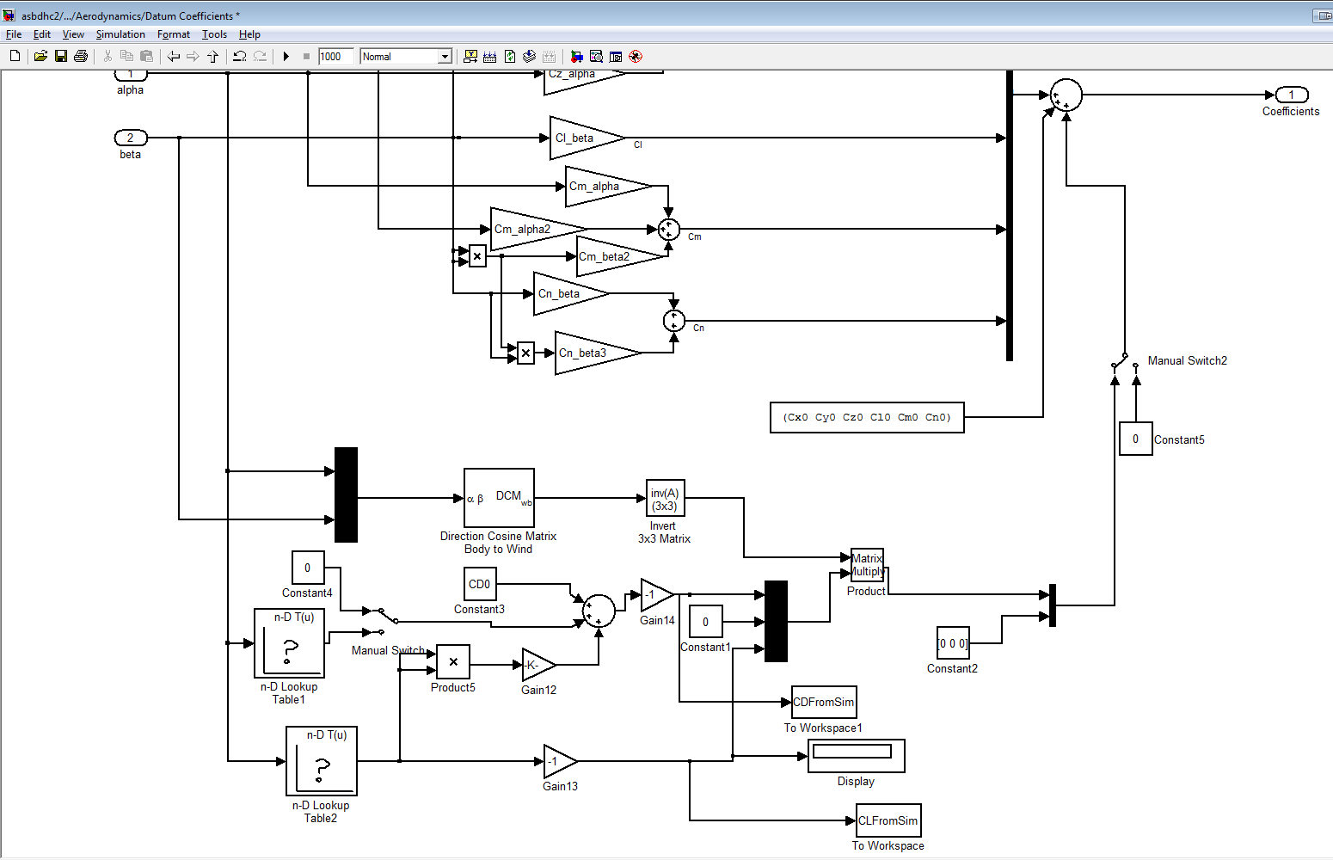
Simulator Development
Modified de Havilland Beaver 6-DOF simulator from Simulink
Scaled mass and moments of inertia to R/C aircraft
Replaced aero forces with drag polar
Removed engine forces and moments
Output required state to workspace for comparison to estimate
Notes:
Simulator modifications

Slide 9
Simulation Output – No Noise
Verified drag polar estimation method
Helped develop data analysis routines
Aided flight test planning
Notes:
Hey look, simulator is working

Slide 10

Random Error
$$σ_{C_{i}}={||J}_{ij}{∗σ}_{j}||= \sqrt{{\left(\frac{∂C_{i}}{∂α}∗σ_{α}\right)}^{2}+{\left(\frac{∂C_{i}}{∂β}∗σ_{β}\right)}^{2}+{\left(\frac{∂C_{i}}{∂\overset{⃑}{a}}∗σ_{\overset{⃑}{a}}\right)}^{2}}$$
Notes:
Now we use sim to propagate random error, and we note heteroskedasticity

Slide 11
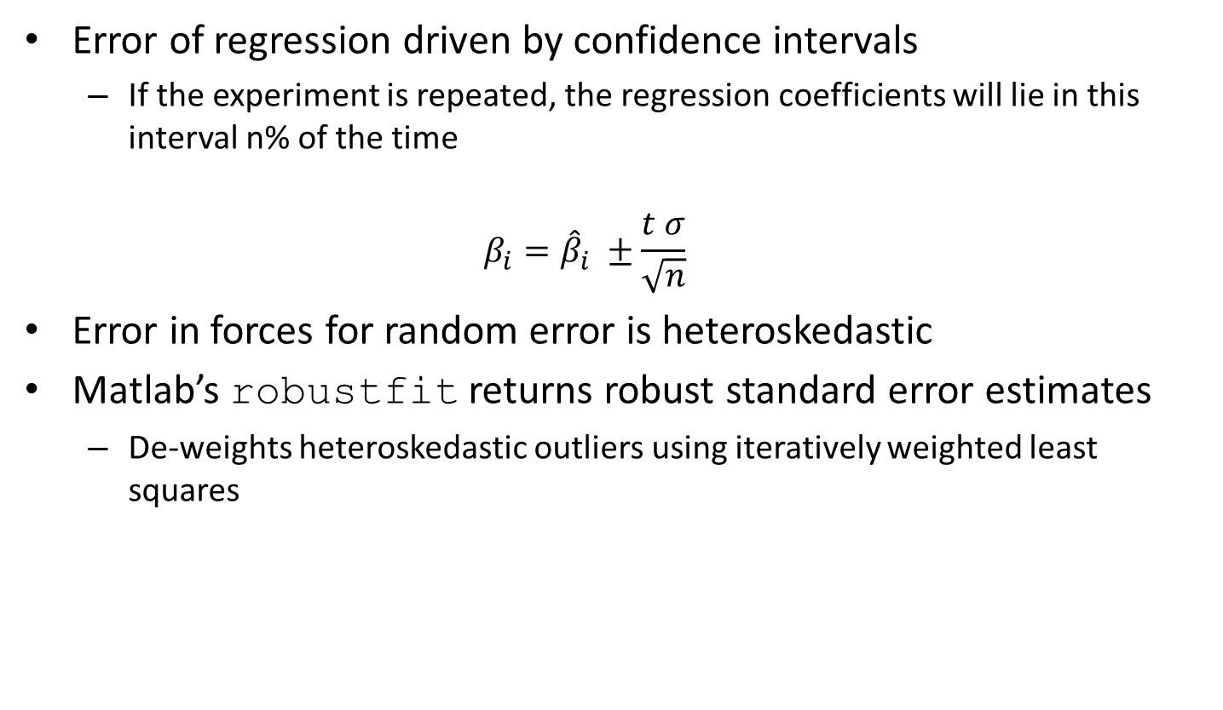
Regression Error
Error of regression driven by confidence intervals
If the experiment is repeated, the regression coefficients will lie in this interval n% of the time
$$β_{i}={\hat{β}}_{i} ±\frac{t σ}{\sqrt{n}}$$
Error in forces for random error is heteroskedastic
Matlab’s robustfit returns robust standard error estimates
De-weights heteroskedastic outliers using iteratively weighted least squares
t = 1.96 for 95% CI
Notes:
With random error propagated, we try to fit curve and deal with heteroskedasticity

Slide 12
Heteroskedasticity
 | C_{D0} | K₁ | K₂
System Inputs | 0.0493 | 0 | 0.03
OLS Estimate | 0.0355 | -0.0136 | 0.0275
Robust LS Estimate | 0.0460 | -0.0037 | 0.0292
Notes:
Hey look how awesome robust regression is.

Slide 13
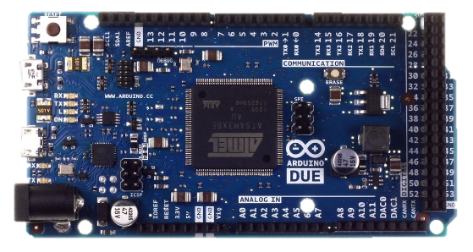
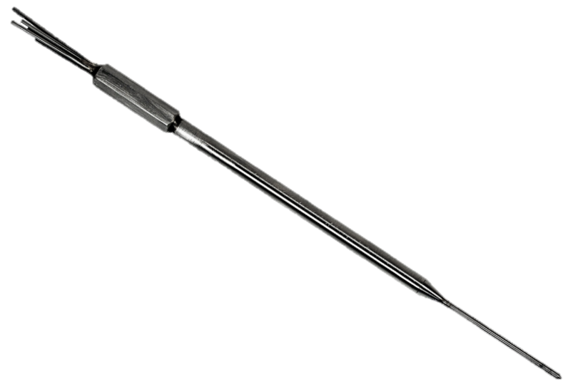
System Architecture
Arduino Due Flight Computer
84 MHz clock
32-bit processor
4 UART channels
Data Acquisition Shield
Custom PCB
Integrates external mag, pressure sensors
Customizable to fit packaging needs
External Air Data System
Custom PCB
Pressure, temperature, and alignment accel
RJ-25 interface
+
Aeroprobe Five-Hole Probe
Calibrated angles to pressures at 70 ft/s

Slide 14
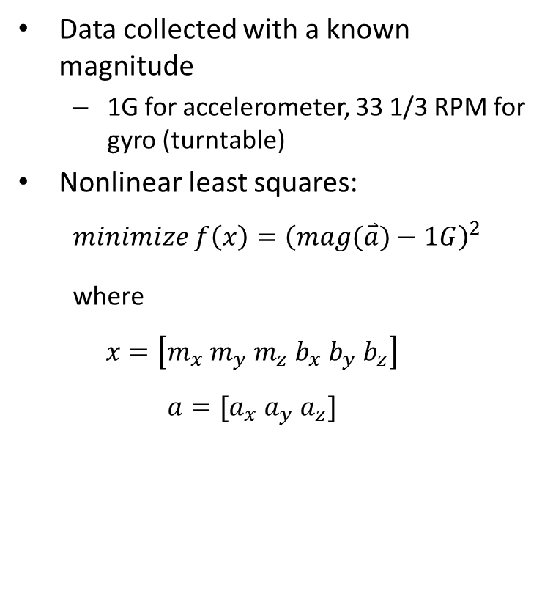
Calibration – Accel/Gyro
Data collected with a known magnitude
1G for accelerometer, 33 1/3 RPM for gyro (turntable)
Nonlinear least squares:
$$minimize f\left(x\right)={\left(mag(\overset{⃑}{a})−1G\right)}^{2}$$
where
$$x=\left[m_{x} m_{y} m_{z} b_{x} b_{y} b_{z}\right]$$
$$a=[a_{x} a_{y} a_{z}]$$

Slide 15
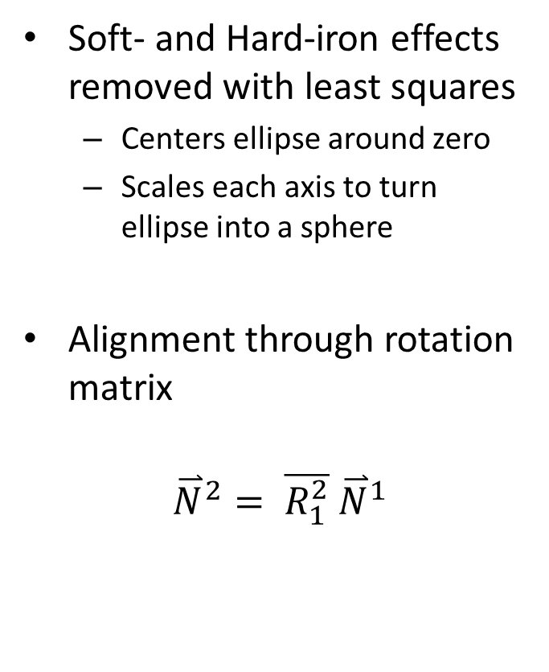
Calibration - Magnetometers
Soft- and Hard-iron effects removed with least squares
Centers ellipse around zero
Scales each axis to turn ellipse into a sphere
Alignment through rotation matrix
$${\overset{⃑}{N}}^{2}= \overline{R_{1}^{2}} {\overset{⃑}{N}}^{1}$$

Slide 16
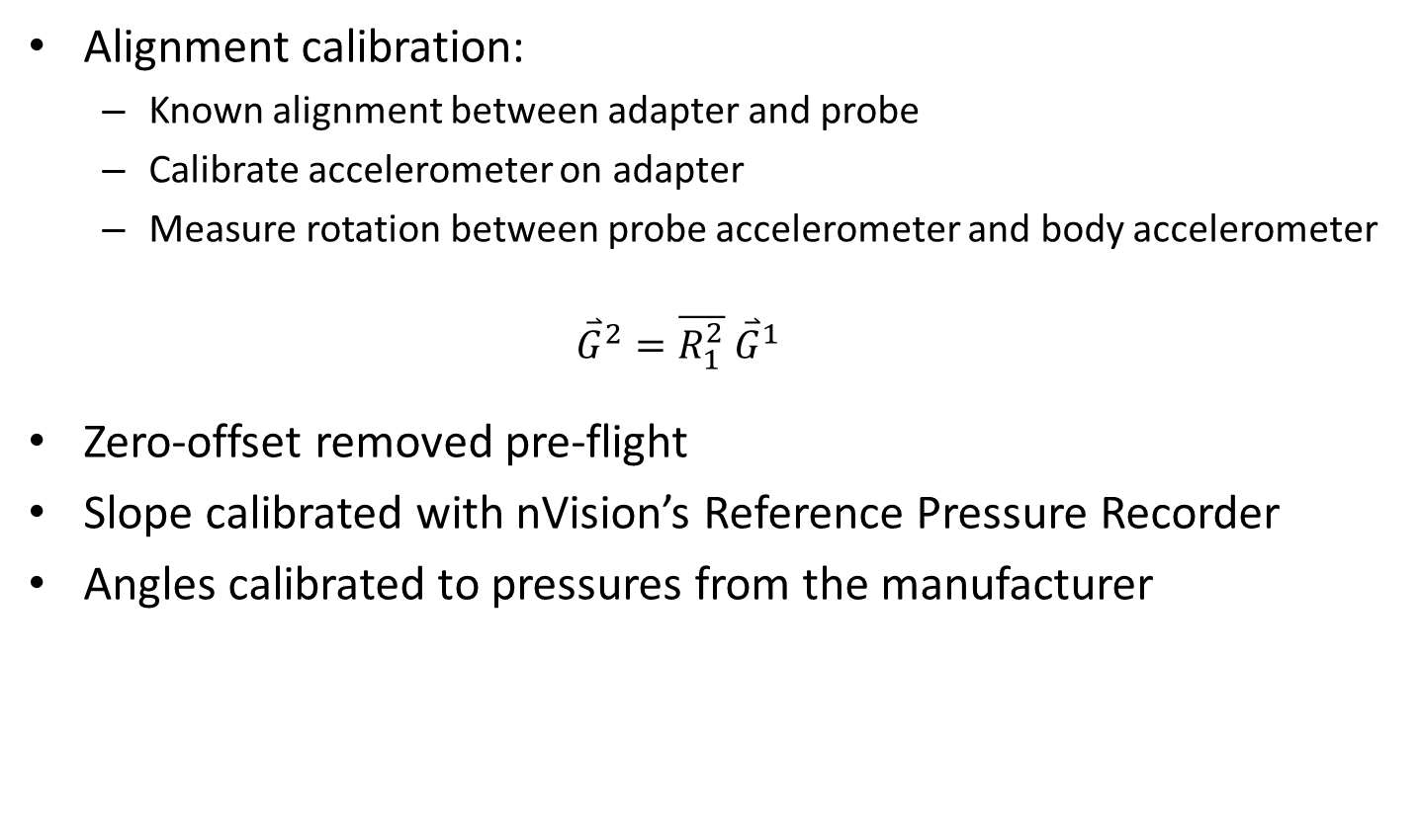
Calibration – Air Data System
Alignment calibration:
Known alignment between adapter and probe
Calibrate accelerometer on adapter
Measure rotation between probe accelerometer and body accelerometer
$${\overset{⃑}{G}}^{2}=\overline{R_{1}^{2}} {\overset{⃑}{G}}^{1}$$
Zero-offset removed pre-flight
Slope calibrated with nVision’s Reference Pressure Recorder
Angles calibrated to pressures from the manufacturer

Slide 17
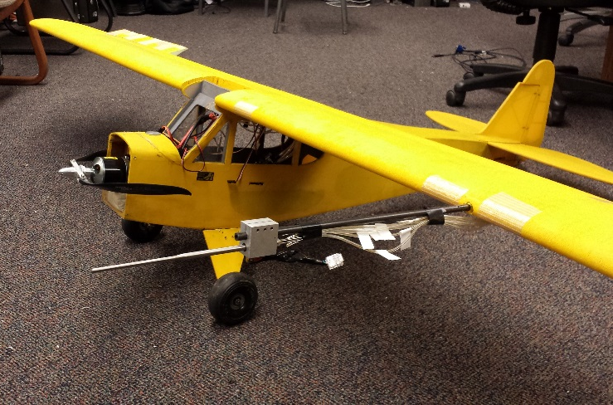
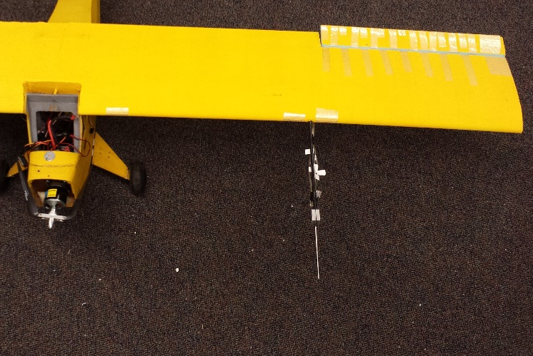
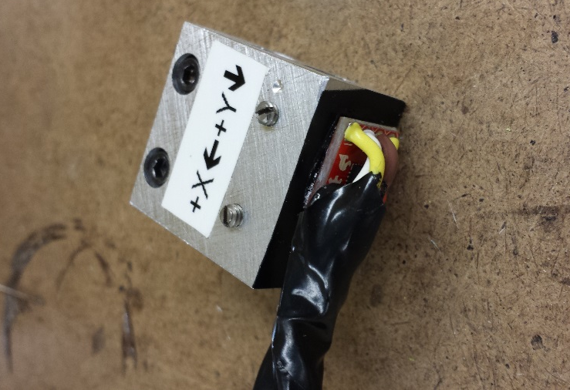
Air Data System Integration

Slide 18
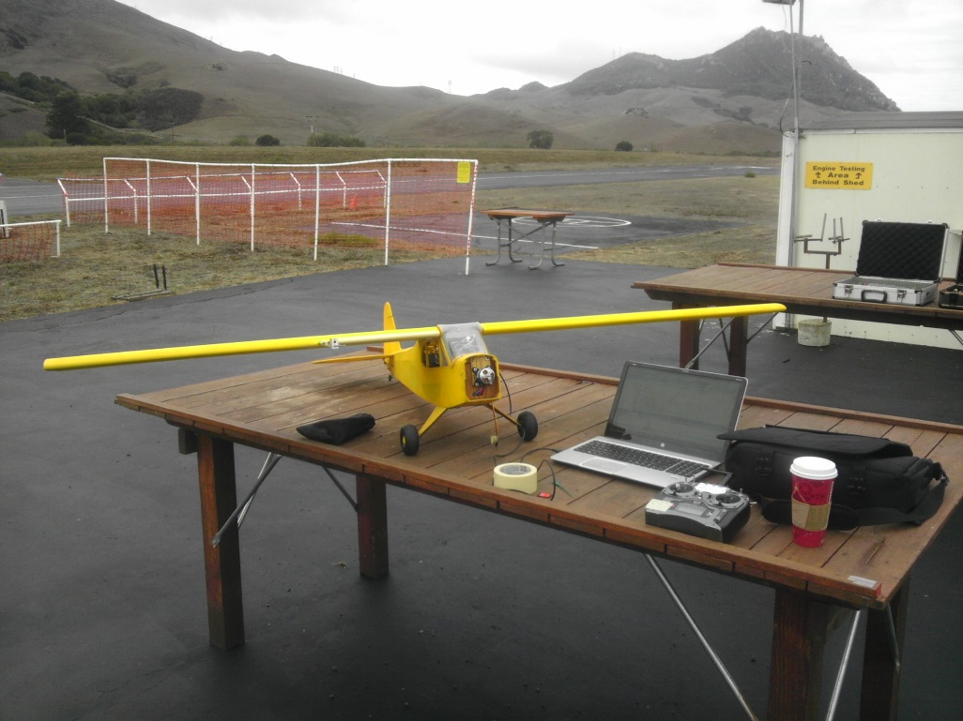
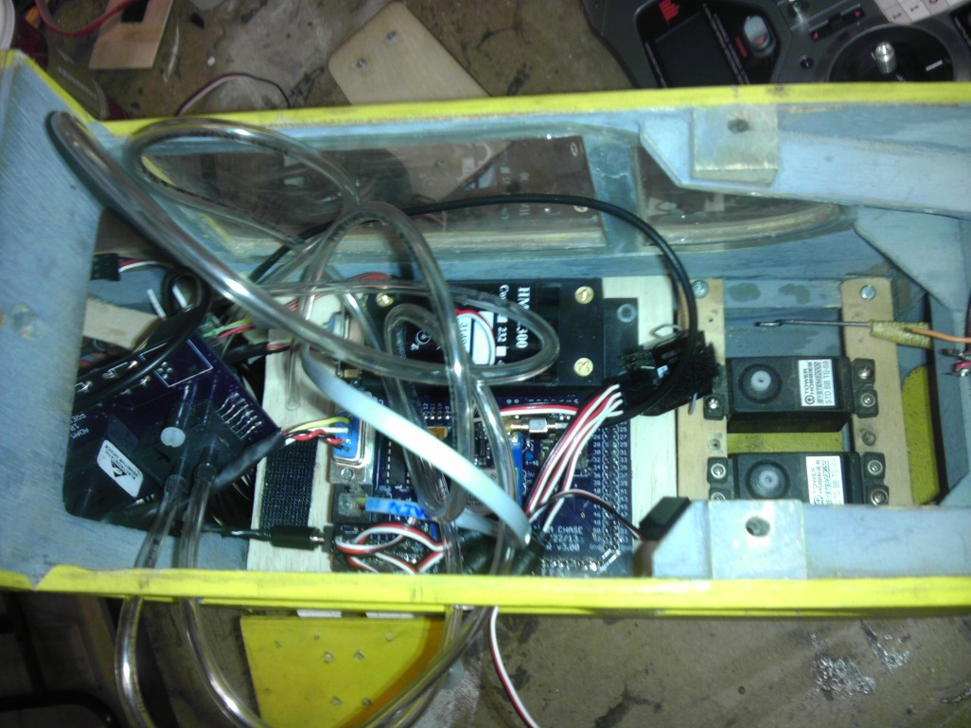
Flight Test

Slide 19
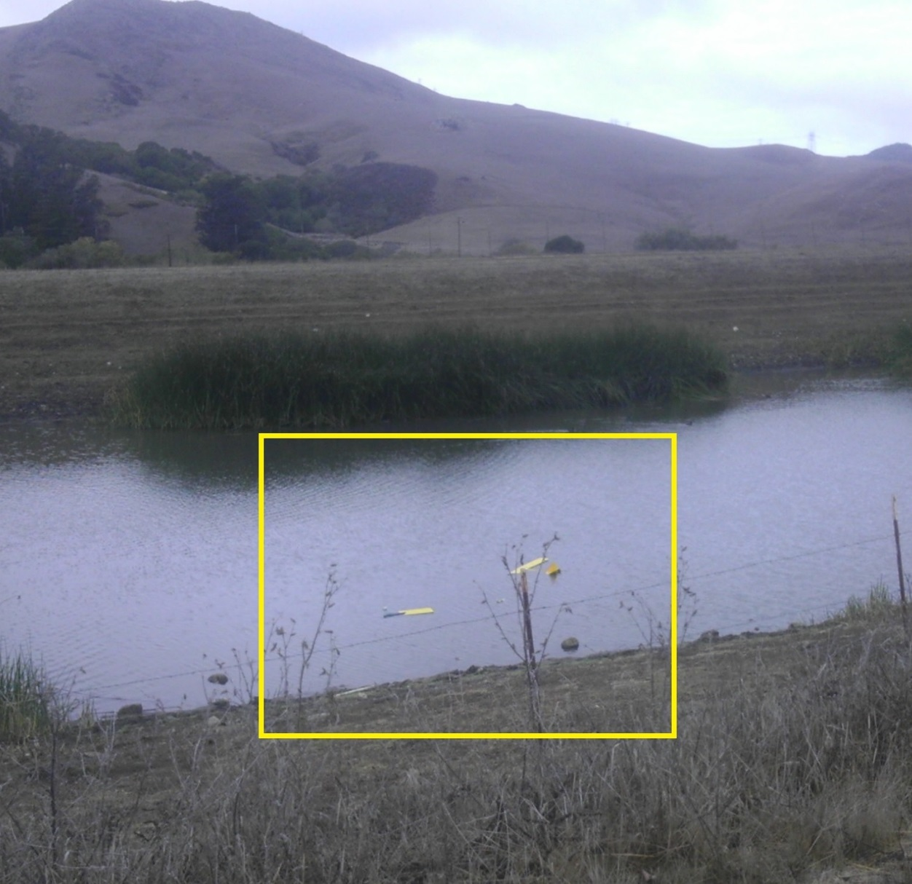
Flight Crash

Slide 20
Future Work
Verify system accuracy
Integrate sensors into an INS solution
Instrument for in-flight thrust measurement
Stability/control derivative estimation

